Slide 1
REQUIREMENTS
unstructured
tiktoken
pinecone-client
pypdf
openai
langchain
numpy
python-dotenv

Slide 2

ARCHITECTURE MVP-1 Code Flow
TEXT CHUNK-1
O
P
ENA
I
EMB
E
DD
I
NG
S
VECTOR-1
TEXT CHUNK-2
VECTOR-2
DATASOURCE
(MEDICAL DATA)
VECTOR SEARCH DB
Applications
Similarity Search
Based on Human Query
TEXT CHUNK-3
VECTOR-3
TEXT CHUNK-4
VECTOR-4

Slide 3
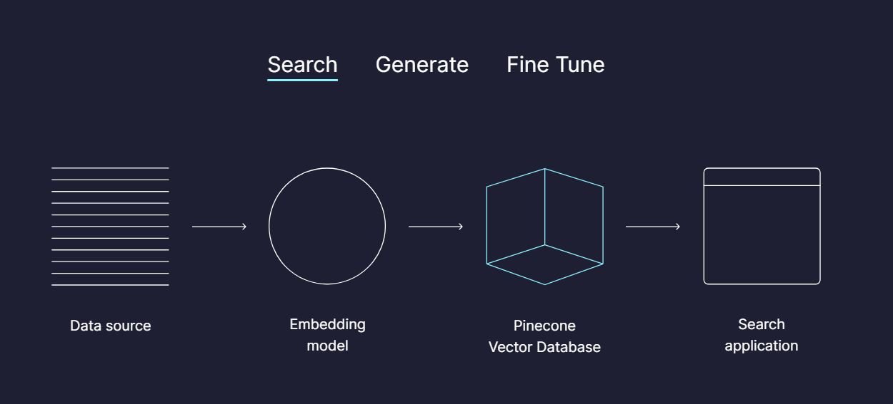
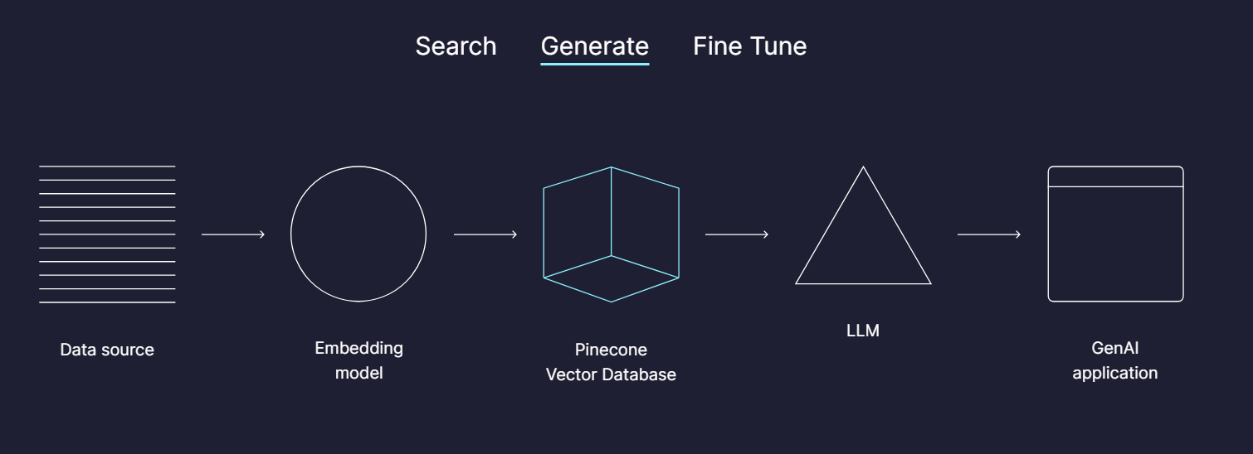

Slide 4
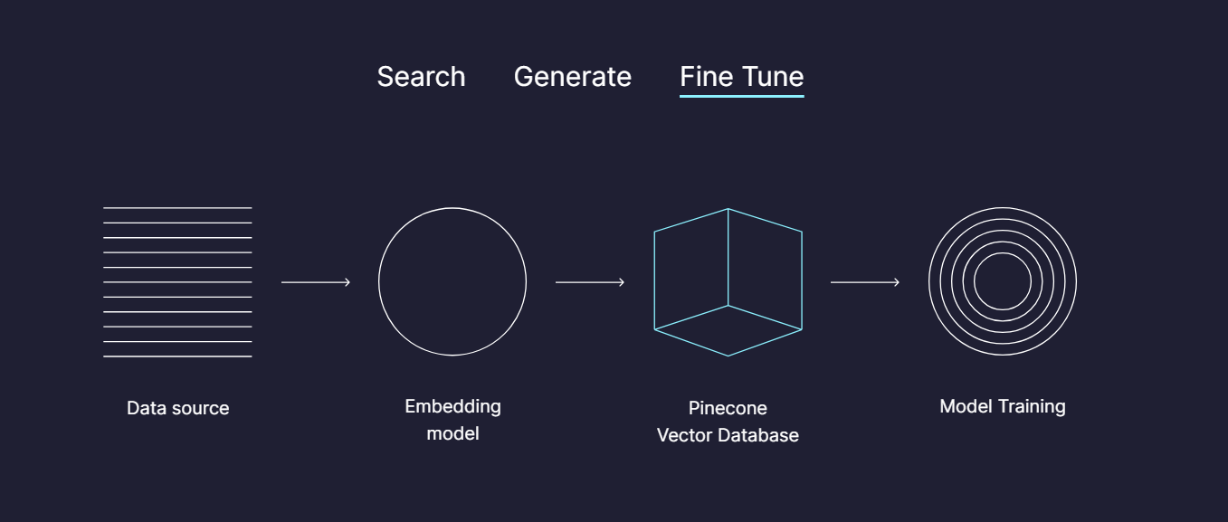

Slide 5
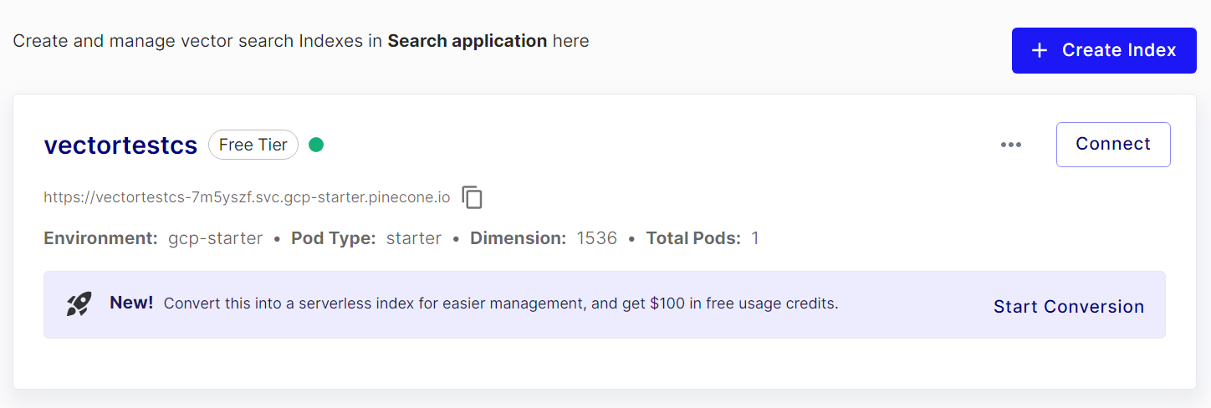
https://vectortestcs-7m5yszf.svc.gcp-starter.pinecone.io

Slide 6
